Slide 1
Limiting Reagent

Slide 2


The limiting reactant (or limiting reagent) is the
reactant that is entirely consumed when a reaction goes to completion

Slide 3
Theoretical yield
Actual yield
Percent yield

Slide 4




Slide 5


Slide 6
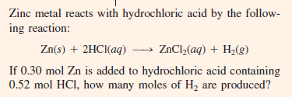
Problem 1

Slide 7
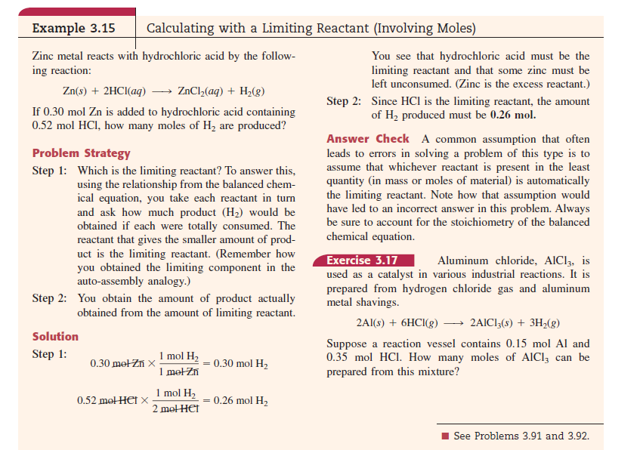
Book: Ebing, page 110

Slide 8
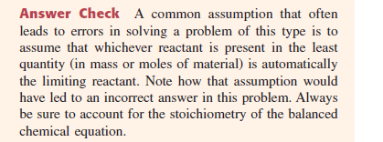

Slide 9

Problem 2

Slide 10



Q2

Slide 11
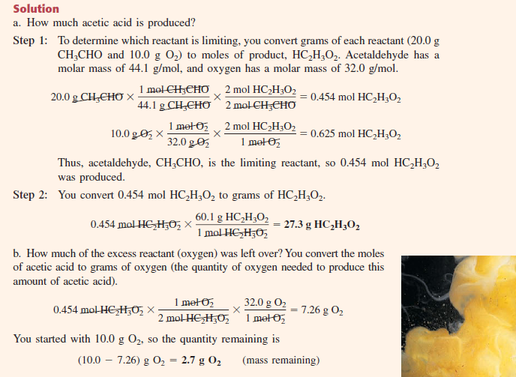

Slide 12


